Slide 1
Design And Analysis of Algorithms Hi-Q game(peg solitaire)
By
Manichand(2010030455)
Dileep reddy(2010030416)
Harsha vardan(2010030173)
Prakash raj(2010030533)
Under the guidance of
Udaya Rani mam

Slide 2
Problem statement and domain
The basic game consists of a cross-shaped board, often made of wood, together with a set of pegs (or alternatively marbles). To start the game, one fills the board with pegs except for the central hole. A jump consists of jumping one peg over another into an empty spot in the board, removing the peg jumped over from the board. Diagonal jumps are not allowed (in the standard version of the game).
The goal of this project is find a solution for a traditional peg solitaire board(HI-Q) (if one exists) or display an error message in case there is no solution.
The method used for this project is backtracking

Slide 3
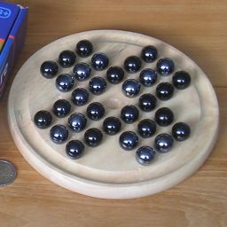
Hi-Q game
(peg solitaire
Game)

Slide 4
Existing solutions/ Naïve solutions
With n pegs,
if there is only n = 1 peg left,
if it is in the center, return indicating we found a solution,
otherwise, we did not;
otherwise, for each possible jump,
modify the board to account for the jump and call the backtracking algorithm recursively, where
if the algorithm indicates success, record the jump and return indicating we found a solution,
otherwise, reset the board to the state it was in prior to making the jump; and
the loop will only finish if none of the possible jumps led to a solution, so return indicating we did not find one.

Slide 5
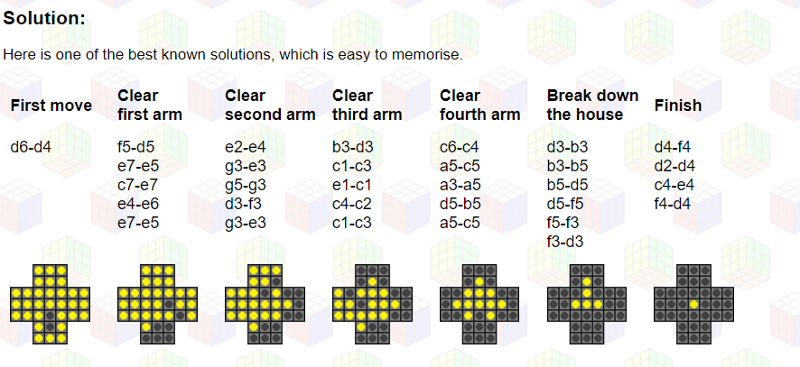

Slide 6
Proposed Algorithm Design Technique
One way to solve peg solitaire is to use a backtracking search algorithm. This algorithm searches for a solution from a given start configuration by making a legal jump J from start, after which it recursively searches for a solution from the new configuration. Since every jump reduces the number of pegs (filled holes) on the board by one, in the base case, the algorithm stops recursing when both start and final have the same number of pegs.

Slide 7
Data Structures needed
the simplest possible example of backtracking, which is searching an actual tree. We will also use the simplest kind of tree, a binary tree.
A binary tree is a data structure composed of nodes. One node is designated as the root node. Each node can reference (point to) zero, one, or two other nodes, which are called its children. The children are referred to as the left child and/or the right child. All nodes are reachable (by one or more steps) from the root node, and there are no cycles. For our purposes, although this is not part of the definition of a binary tree, we will say that a node might or might not be a goal node, and will contain its name. The first example in this paper (which we repeat here) shows a binary tree.

Slide 8

Github setup

Slide 9
Division of work among the group members
Manichand – understanding the flow of game and analysis of game. Harsha vardan – searching for Python libraries needed for game
Dileep reddy – understanding algorithm of existing solutions
Prakash raj – understanding data structures involved in game

